Slide 1




Group 3's
OLIST ECOMMERCE ANALYSIS

Slide 2

Team members
Chandan Giri
Business Analyst
Deepika Raghav
Business Analyst
Jagruti Kawanpure
Data Analyst
Pragati Padole
Data Analyst
Santhya Sekhar
Data Analyst
Sayali Patil
Data Analyst

Slide 3

Introduction
Olist, founded in 2015, is a thriving Brazilian e-commerce platform that serves as a vital connection between small and medium-sized businesses and major marketplaces, including Mercado Livre, Amazon, and Americanas.com.
Olist equips their sellers with essential tools and infrastructure to excel in the fiercely competitive e-commerce landscape.
The objective of our presentation on Olist dataset analysis is to deliver valuable insights and practical information derived from thorough data analysis.
The goal is to uncover significant patterns, trends, and relationships within the dataset, enabling strategic decision-making and optimization of various aspects of Olist's operations.

Slide 4

CONTENTS
Data overview
Weekday vs weekend payment statistics.
Number of orders with review score 5 and payment type credit card.
Average delivery days taken by pet shop.
Average price and payment of Sao Paulo city.
Average shipping days vs review score.
Olist store anaylsis dashboard
Extra KPIs
Excel Dashboard
Power BI Dashboard
Tableau Dashboard
SWOT Analysis
Conclusion

Slide 5
Data overview
ORDERS
CUSTOMERS
Shipping details, geographical details, customer details, purchase date, delivery date, & order status
Customer behaviour, reviews, payment statistics, payment types, & geographical details.
PRODUCTS
SELLERS
Product category, review scores, overall experience, & customers feedback
Seller id, seller name, & geolocation

Slide 6
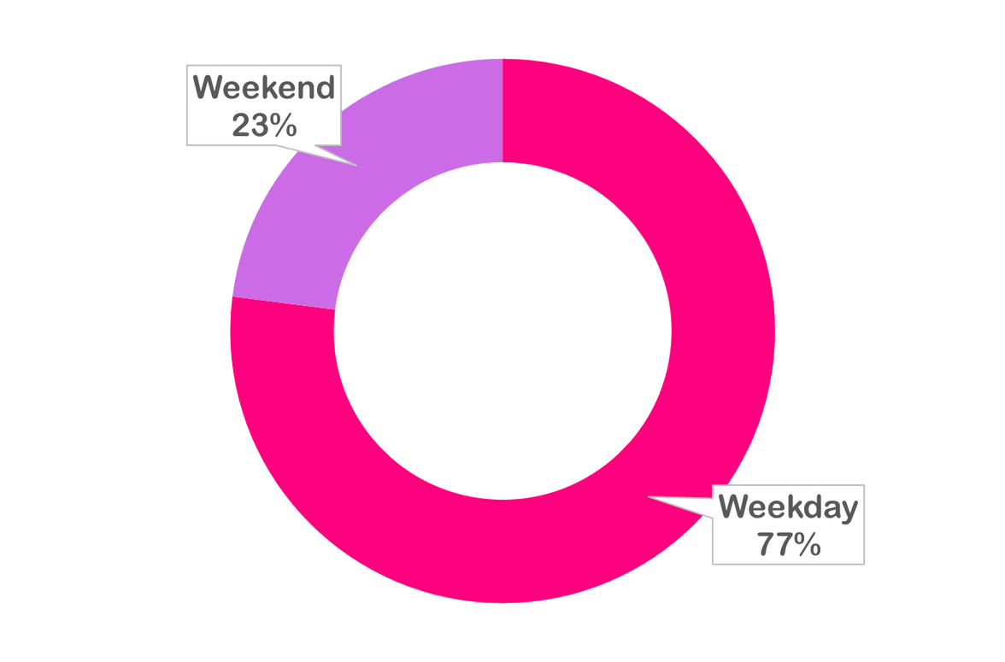

WEEKDAY VS WEEKEND PAYMENT STATISTICS
As per the chart we observed that the sales was more on the weekday than on the weekend.
Attract customers with exclusive weekend offers, limited-time discounts, deals, and promotions.
Enhance the website and mobile app for a flawless weekend user experience. Prioritize mobile-friendliness, reduce load times, and streamline the purchasing process for seamless interactions.
Use customer data and past purchase history to personalize offers and recommendations for individual customers, increasing the likelihood of a weekend sale.

Slide 7
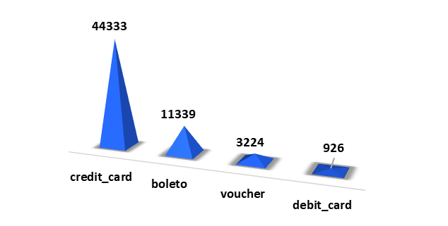

NUMBER 0F ORDERS WITH REVIEW SCORE 5 AND PAYMENT TYPE AS CREDIT CARD
After analyzing the data, we found that the number of orders with a review score of 5 and payment type as credit card is 44333.
Customers who rated their orders with a score of 5 represent a highly satisfied segment, indicating positive experiences with their purchases.
The prevalence of credit card payments among these highly satisfied customers suggests that credit cards are a preferred and reliable payment method for successful transactions.

Slide 8


AVERAGE DELIVERY DAYS TAKEN BY PET SHOP
After analyzing the data, we found that the average delivery days for the pet shop were 11 days.
Segment the data based on delivery locations to determine if there are any variations in delivery days across different regions.
Explore the impact of delivery services used (e.g., internal delivery team, third-party logistics) on delivery days.
Investigate any correlations between order volume and delivery days to assess if increased order volumes affect delivery efficiency.

Slide 9
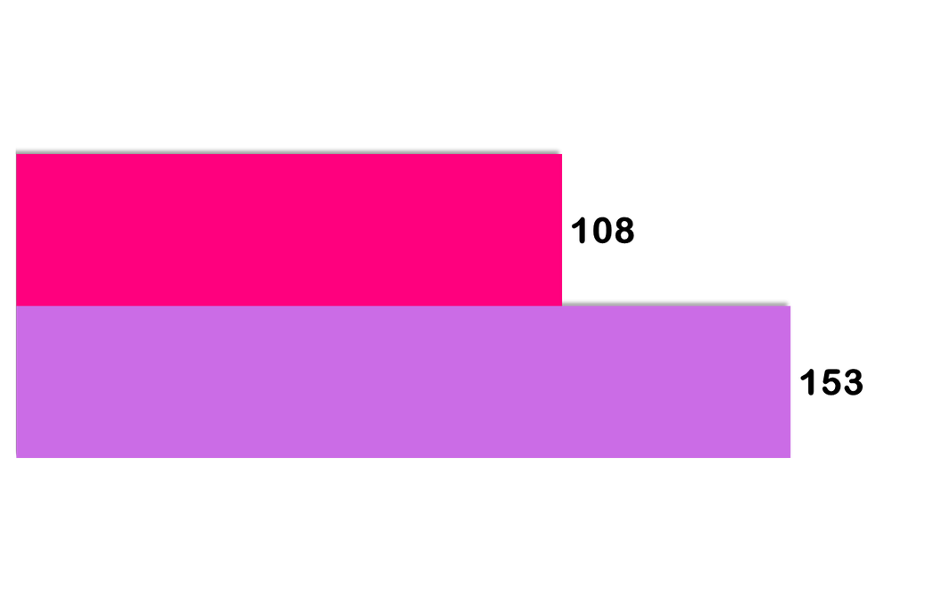
AVERAGE PAYMENT VALUE & PRICE OF SAO PAULO CITY
Upon analyzing the data, we found that the average payment value in Sao Paulo City is 153. This metric provides insights into the spending habits and purchasing power of consumers in the city.
Based on the dataset, the average price of goods and services in Sao Paulo City is 108. This metric helps gauge the cost of living and economic activity in the region.
The average price reveals the general price level and affordability of goods and services in Sao Paulo City.
Avg price
Avg payment value

Slide 10
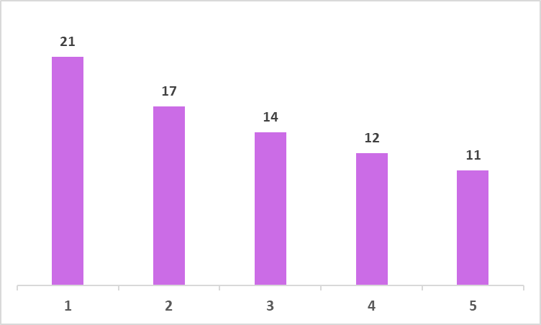
AVERAGE SHIPPING DAYS VS REVIEW SCORE
After analyzing the data, we found that the average shipping days for review scores 1 to 5 is from 21 to 11. This metric provides insights into the typical time it takes for orders to be delivered to customers.
The findings underscore the significance of efficient shipping processes. Timely deliveries play a crucial role in meeting customer expectations and ensuring positive reviews, leading to customer loyalty and repeat business.
Conduct sentiment analysis on customer reviews to identify specific shipping-related factors that contribute to positive or negative experiences.

Slide 11
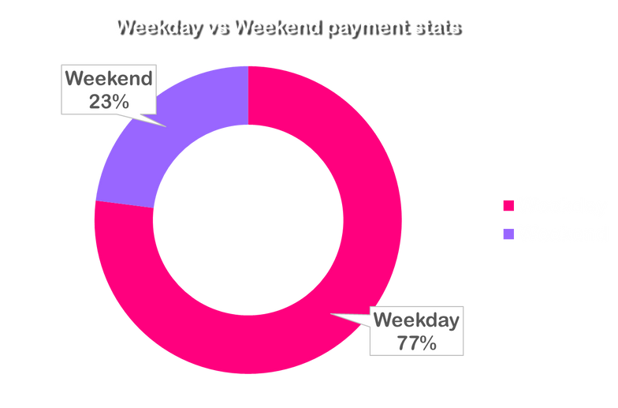
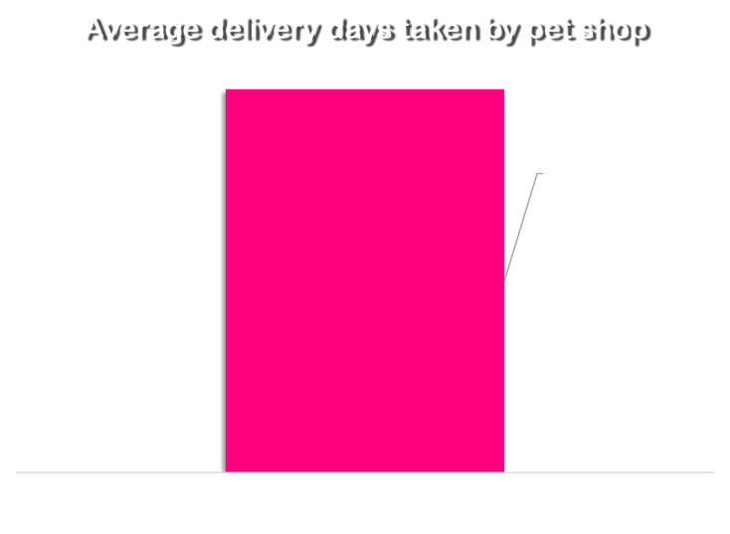
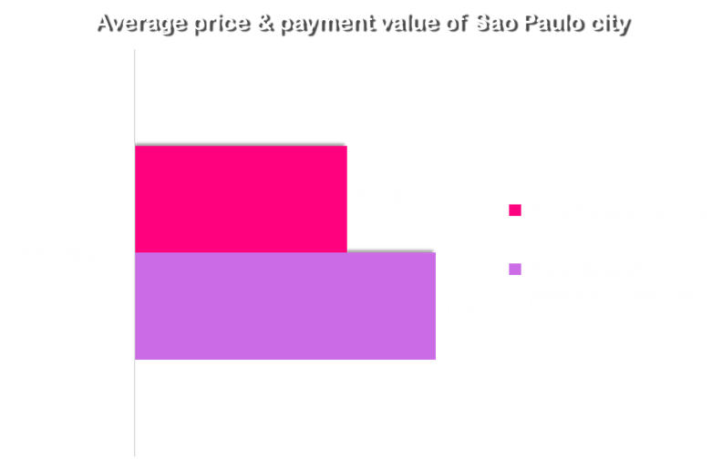

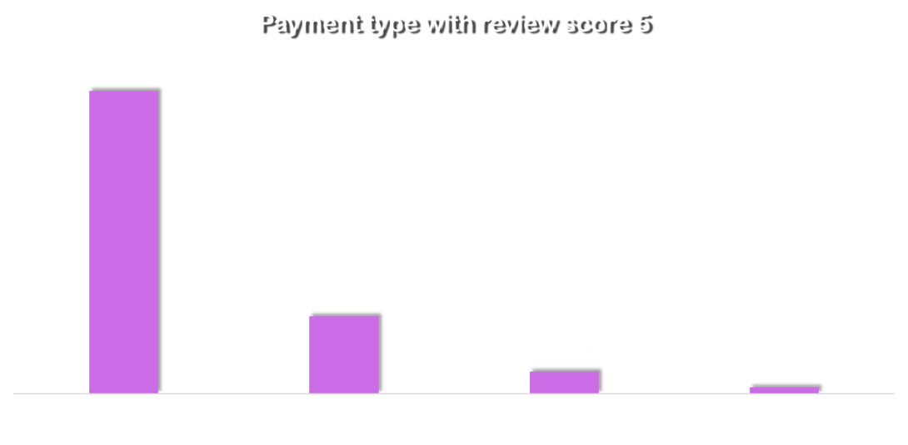
OLIST STORE ANAYSIS
DASHBOARD
Total Payment
$ 16.01 M
Total orders
99422
Total products
32951
Total sellers
3095

Slide 12
SWOT Analysis
STRENGHTS
WEEKNESS
Extensive Product Variety
Robust Seller Network
Strong Customer Base
Efficient Delivery System
Intense Competition
Limited International Presence
Reliance on Third-Party Logistics
OPPORTUNITIES
THREATS
Market Expansion
Strategic Partnerships
Mobile Commerce
Enhanced Customer Experience
Competitive Pressure
Changing Consumer Preferences
Economic Factors
Regulatory Challenges

Slide 13
SWOT Analysis conclusion
By leveraging its strengths, addressing weaknesses, capitalizing on opportunities, and mitigating threats, Olist can position itself for continued growth, customer satisfaction, and competitive advantage in the dynamic e-commerce landscape. Strategic decision-making, innovation, and customer-centric approaches will be crucial for sustained success.

Slide 14
Conclusion
Analyzing payment statistics for weekdays and weekends reveals consumer spending behaviors, enabling businesses to customize payment options and marketing strategies accordingly. By understanding payment type distribution and average transaction values, businesses can enhance customer satisfaction, improve conversion rates, and drive growth.
Analyzing orders with a review score of 5 and credit card payments uncovers insights into customer satisfaction and preferences, enabling businesses to tailor payment options and customer service strategies.
Analyzing average delivery days taken by a pet shop helps identify areas for improvement, optimizing delivery processes and enhancing customer satisfaction.
Analyzing average payment value and price in Sao Paulo City provides insights for pricing strategies, market positioning, and resource allocation.
Analyzing the relationship between average shipping days and review scores emphasizes efficient shipping operations, improving customer satisfaction and brand perception.

Slide 15
Thank you

